Slide 1
Teach reading: change lives
Parent workshop: Phonics and early reading

Slide 2
A love of reading is the biggest indicator of future academic success.
OECD (The Organisation for Economic Co-operation and Development)

Slide 3


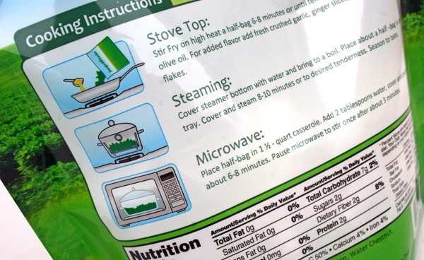
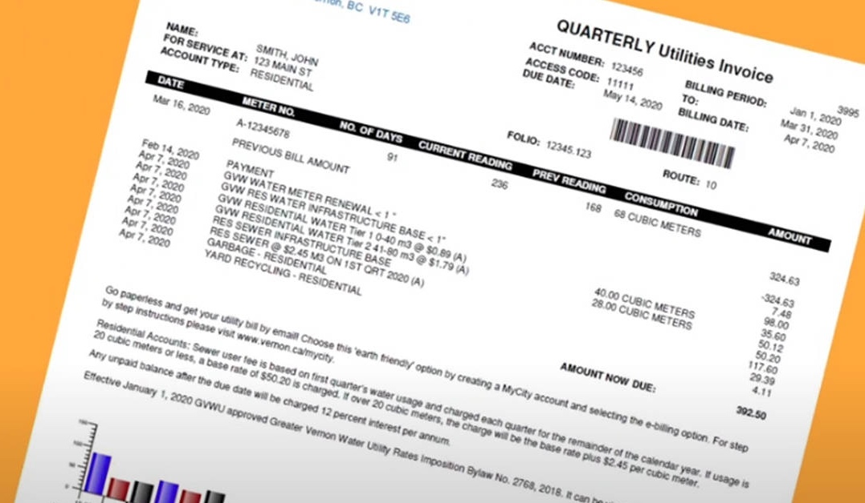
How many times have you already read today?
Notes:
Just think about how many times you have already read things today. It really is a vital skill.

Slide 4

Phonics

Slide 5
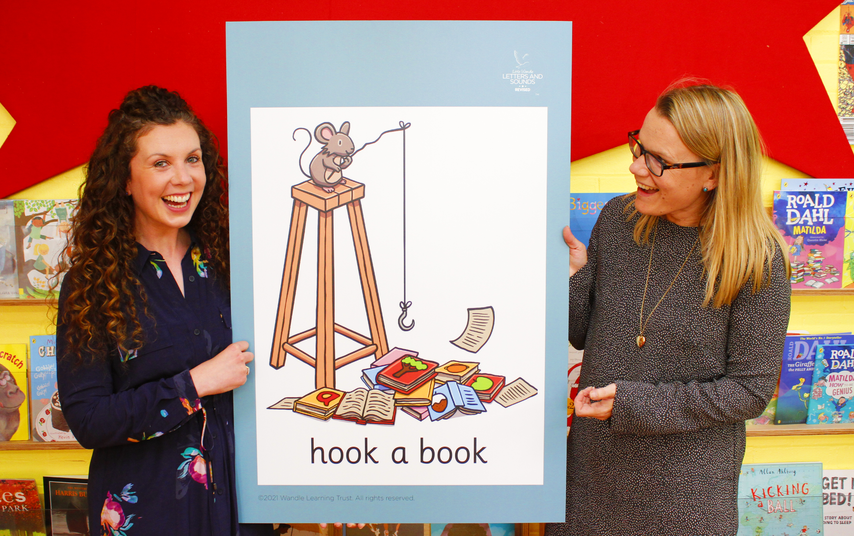
Little Wandle Letters and Sounds Revised
Our school has chosen
Little Wandle Letters and Sounds Revised as our systematic, synthetic phonics (SSP) programme to teach early reading and spelling.
Notes:
Government changes mean a change (for the better) in how we teach phonics and reading at school - there needs to be consistency throughout the early reading stage.
The early reading is the stage where children are learning to become fluent readers through the use of phonics. As a school we did a lot of research into all of the different Phonics schemes validated by the DFE. We felt that Little Wandle was the best fit for our children, parents and staff. We like their use of resources, mnemonics and phrases, lesson structure, assessment, matched reading books and their use of catch up sessions. Which will all be spoken about throughout this powerpoint.

Slide 6
Phonics is:
making connections between the sounds of our spoken words and the letters that are used to write them down.
Notes:
It sounds complicated but it really isn’t!

Slide 7
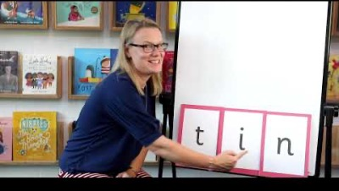
Blending to read words
Notes:
Some children learn to blend really quickly, and others take a little longer. If your child is finding it difficult, ask your child’s teacher for ways to help at home – playing blending games at home is so helpful!
Show parents this video from the website: https://www.littlewandlelettersandsounds.org.uk/resources/for-parents/

Slide 8
Terminology
Phoneme
Split vowel digraph
Grapheme
Segment
Digraph
Blend
Trigraph
Notes:
Phoneme – how to say a sound.
Grapheme – how a sound is written.
Digraph – 2 letters that make 1 sound – eg ai, ee
Trigraph – 3 letters that make 1 sound air, igh, ear
Split vowel digraph – formerly known as ‘ a magic e’ so a-e in cake o-e in cone
Segment – splitting a word down into phonemes and sounding them out c-a-t or ch-ee-r
Blend – using the phonemes used to segment putting them all back together again c-a-t ‘cat’.

Slide 9
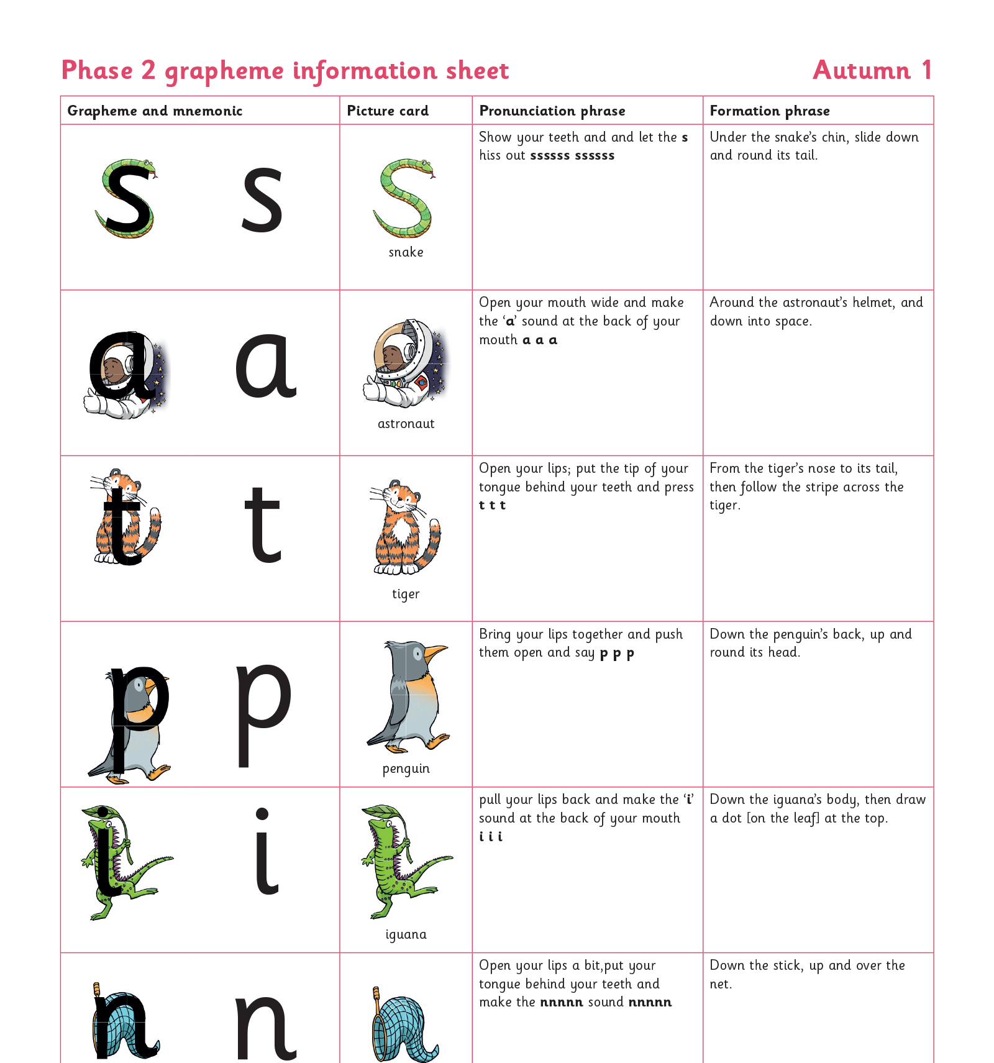
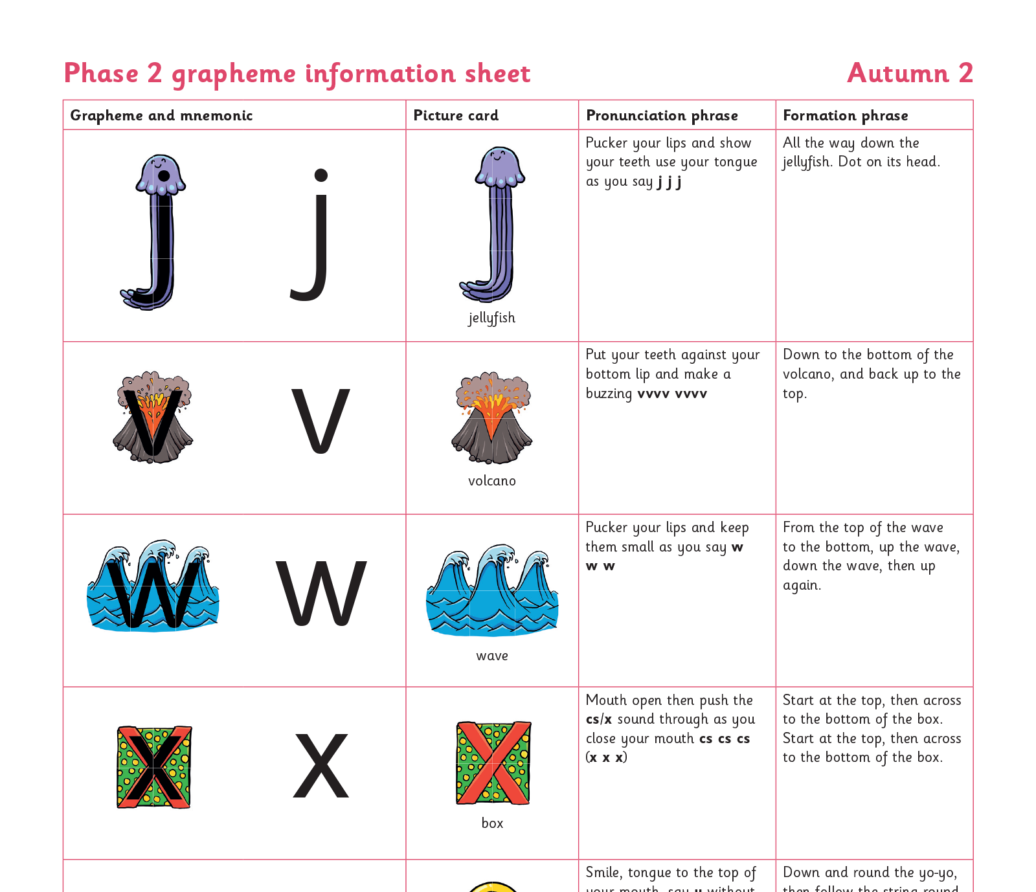
Teaching order
Notes:
We usually teach four new sounds a week and have a review lesson on a Friday. We will send home information on the sounds your child has learnt that week in school. Please try and practice these at home. It should be in short bursts.

Slide 10
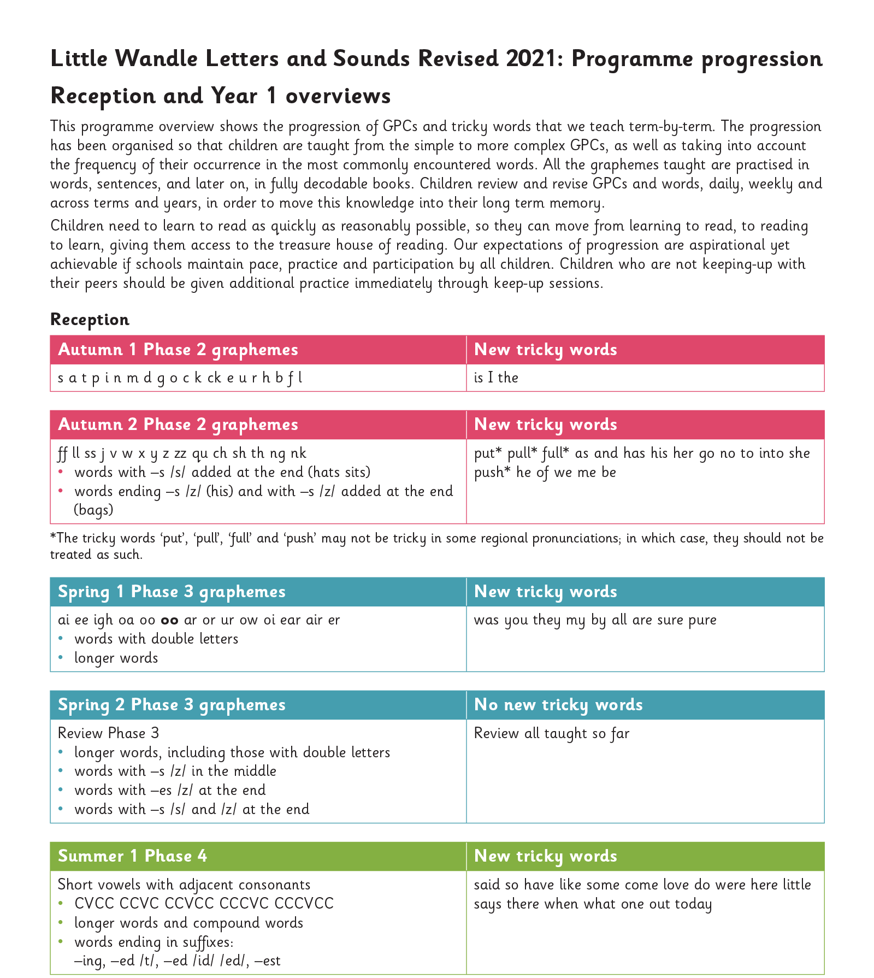
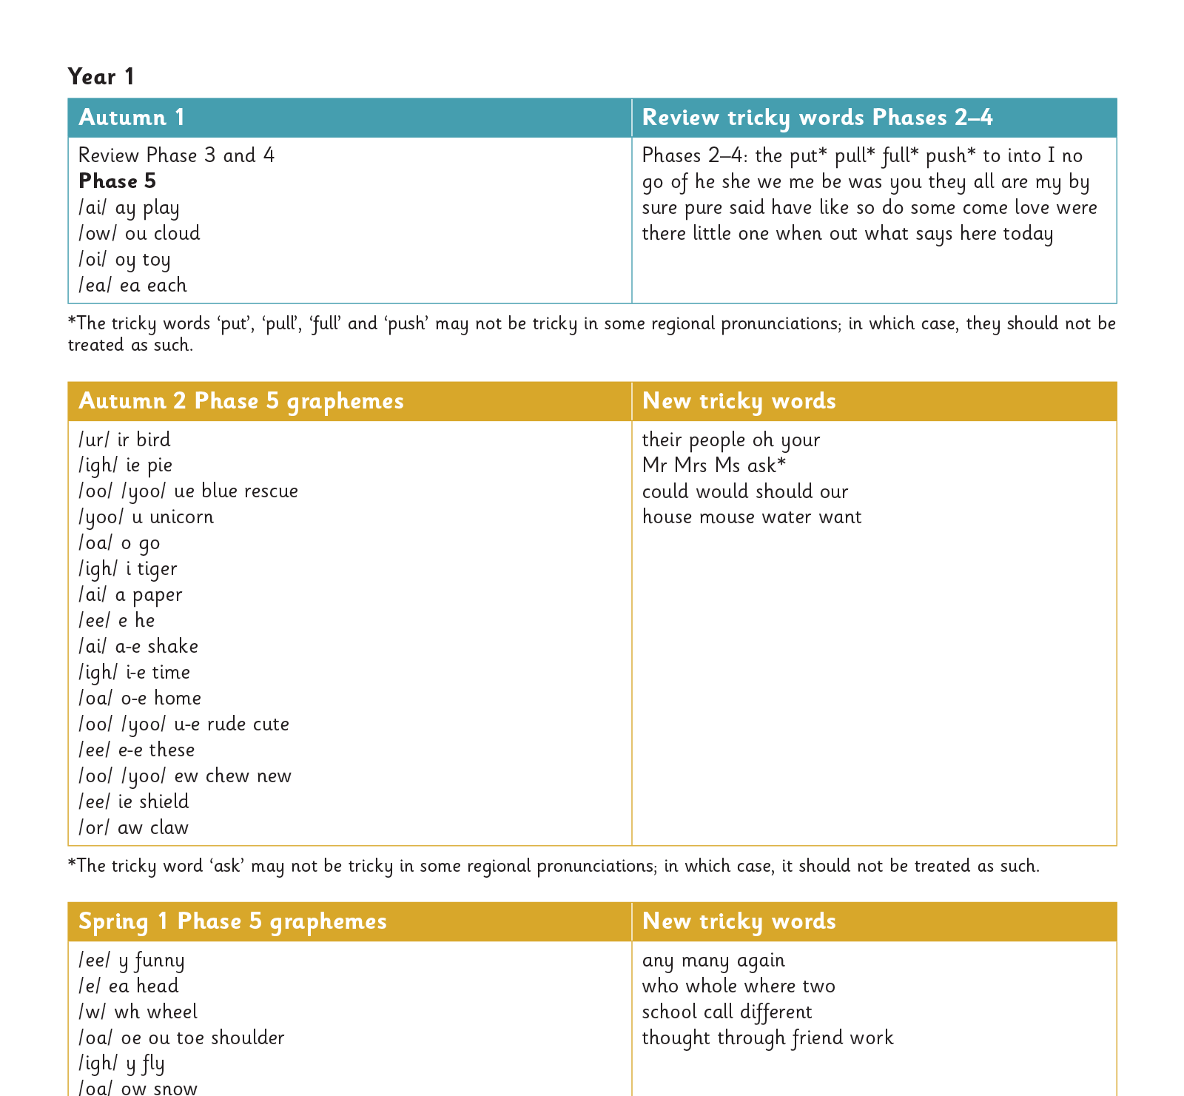
The entire alphabetic code:
Notes:
We will work our way through the whole Little Wandle Programme until your child can read fluently. At the end of each half term children will be assessed. This highlights sounds that we need to recap as a class, small group or 1:1. A huge benefit to this phonics programme is the importance of catch up. There will be daily catch up sessions ran for children who may need a little extra help that was noticed in the class phonics sessions. There are also excellent resources for interventions if children are struggling with phonics and need some extra support. These catch up sessions are short five/10 minute sessions for extra practice and recap that follow on from the days lessons.

Slide 11
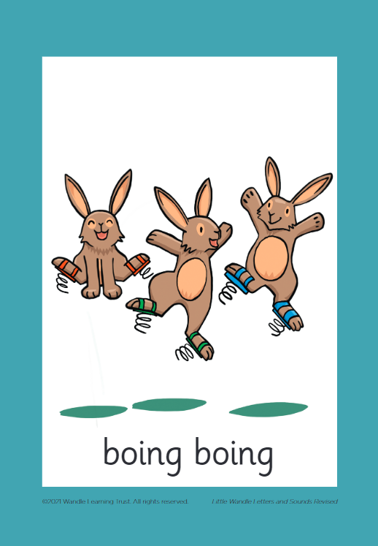



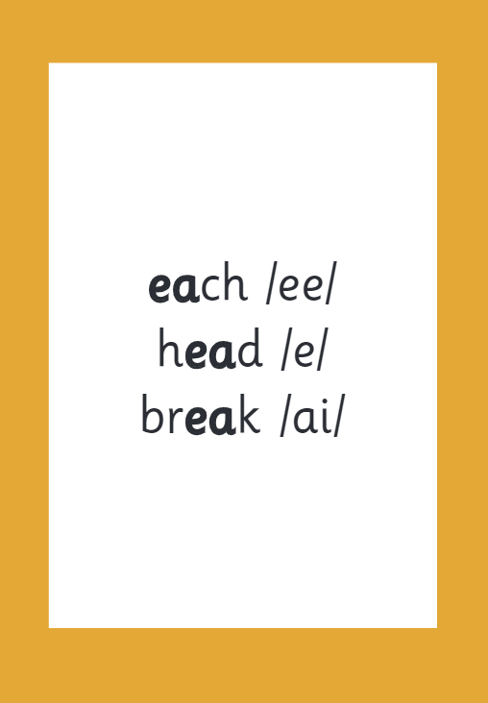

How we make learning stick
Notes:
There are specific resources for the Little Wandle Programme which the children will be very familiar with. Each sound that we teach to begin with has either a mnemonic (like the astronaut that you can see here) or a phrase like boing-boing for ‘oi’. This helps the children recognise and remember the graphemes. Every time we teach a new sound, we also read words during the phonics lesson that contain that new sound so that the children practise what they have learned. We then go on to reading a sentence containing some of those words. We have displays in the classroom and resources available on the tables to support the children throughout the day.

Slide 12
Reading and spelling

Slide 13
Reading and spelling
Notes:
This is an example of what the children learn in Year 1.
Children learn that there are graphemes that can have different sounds and sounds that can be made with different letters.
Use the backs and fronts of Phase 5 cards to show ‘ea’ and ‘ow’.

Slide 14
They will also learnall the different ways to write the same phoneme. phoneme sh:
shell
chef
special
caption
mansion
passion
Notes:
This shows how complicated the English language is.

Slide 15
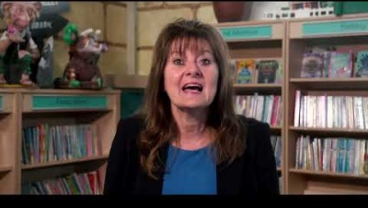
Tricky words
Notes:
Have a look at this video on the website: https://www.littlewandlelettersandsounds.org.uk/resources/for-parents/

Slide 16

Spelling
Say the word.
Segment the sounds.
Count the sounds.
Write them down.
Notes:
Model the process on a flipchart for the parents to see.
Please
P-l-ea-se
4 sounds (counted on fingers)

Slide 17
How do we teach reading in books?
Reading practice sessions are:
timetabled three times a week
taught by a trained teacher/teaching assistant
taught in small groups.
Notes:
The children read the same book three times in a week. The first time we work on decoding (sounding out) the words, the second time we work on prosody which is reading with expression – making the book sound more interesting with our story-teller voice or our David Attenborough voice for information books – and the third time we look at comprehension. We read the books three times at school because we want to develop the fluency. The more the children see words the more they begin to read them automatically without having to sound them out.

Slide 18
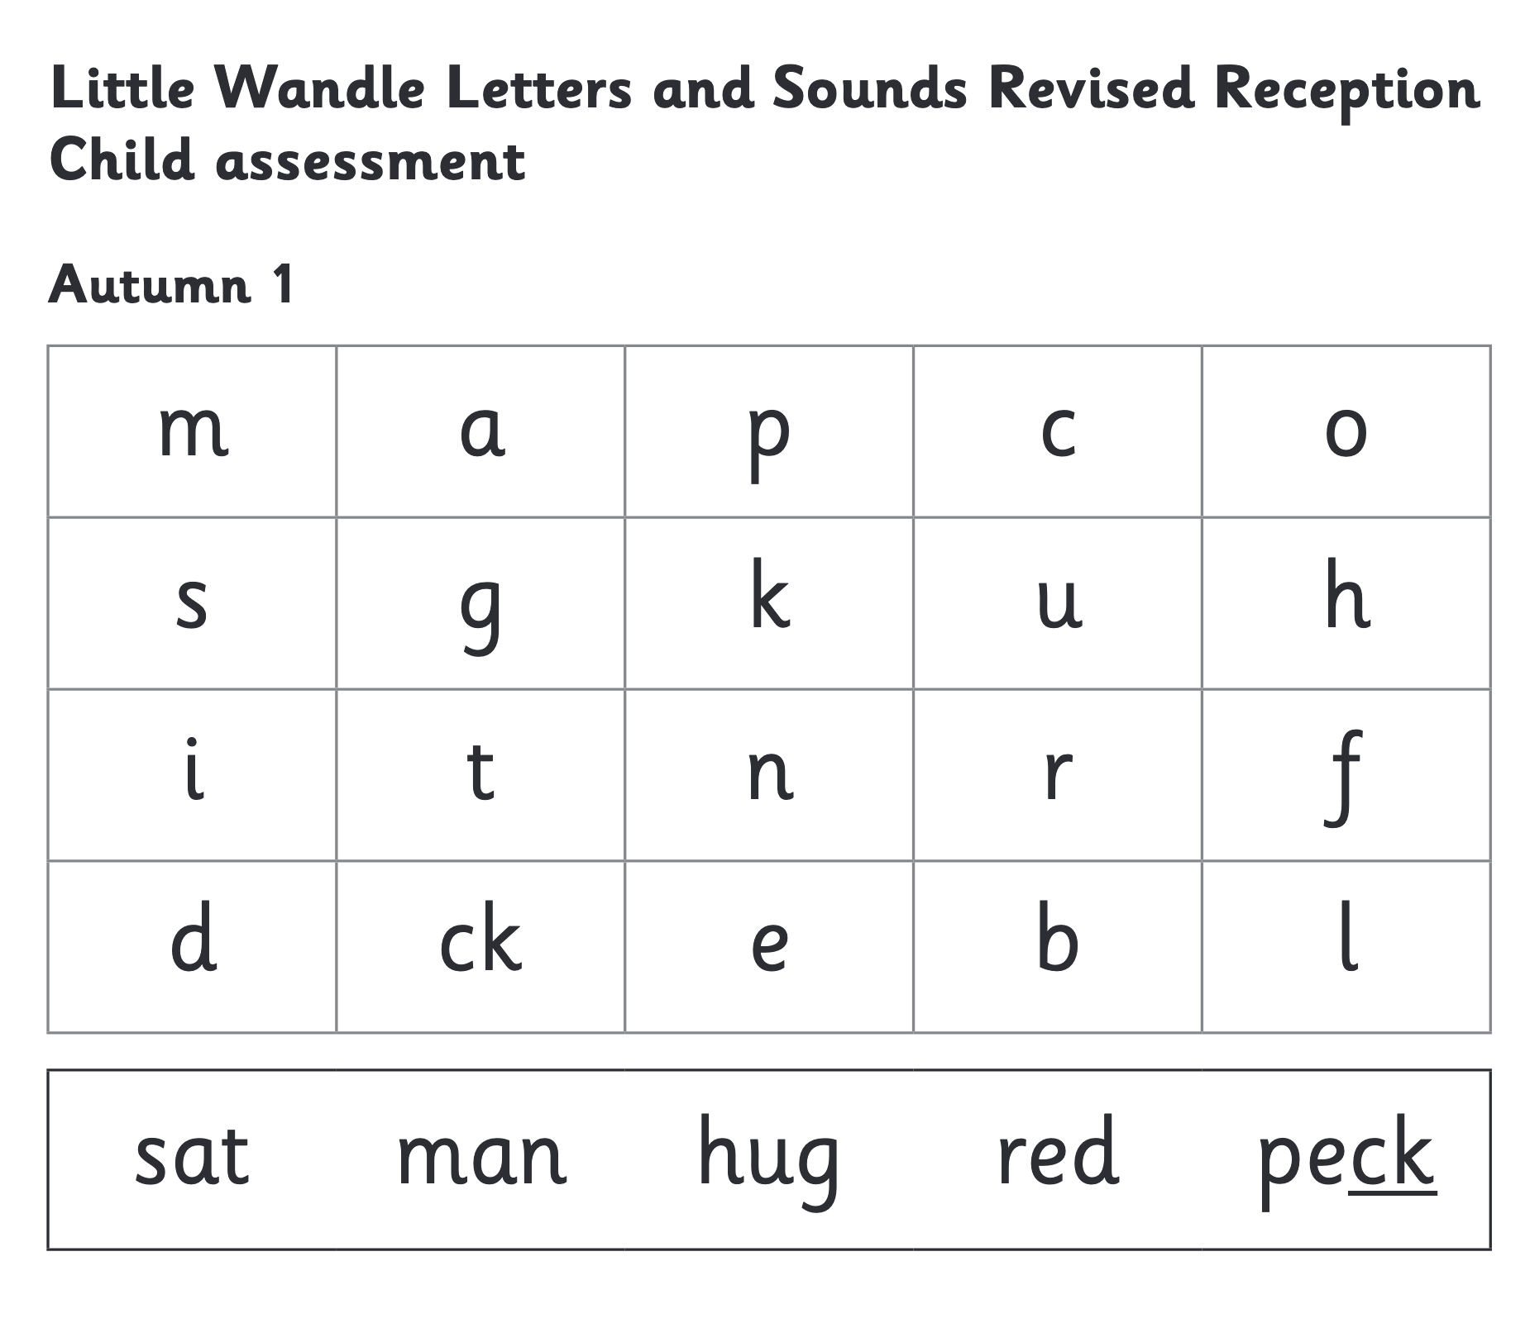
We use assessment to match your child the right level of book
Notes:
We assess your child every six weeks to check progress. Any child who needs extra support has daily keep-up sessions planned for them. This assessment feeds in to the reading sessions and the books your child is reading. Helping them to read at the correct level for their ability. The regular assessment allows us to help children thrive and progress quickly.

Slide 19
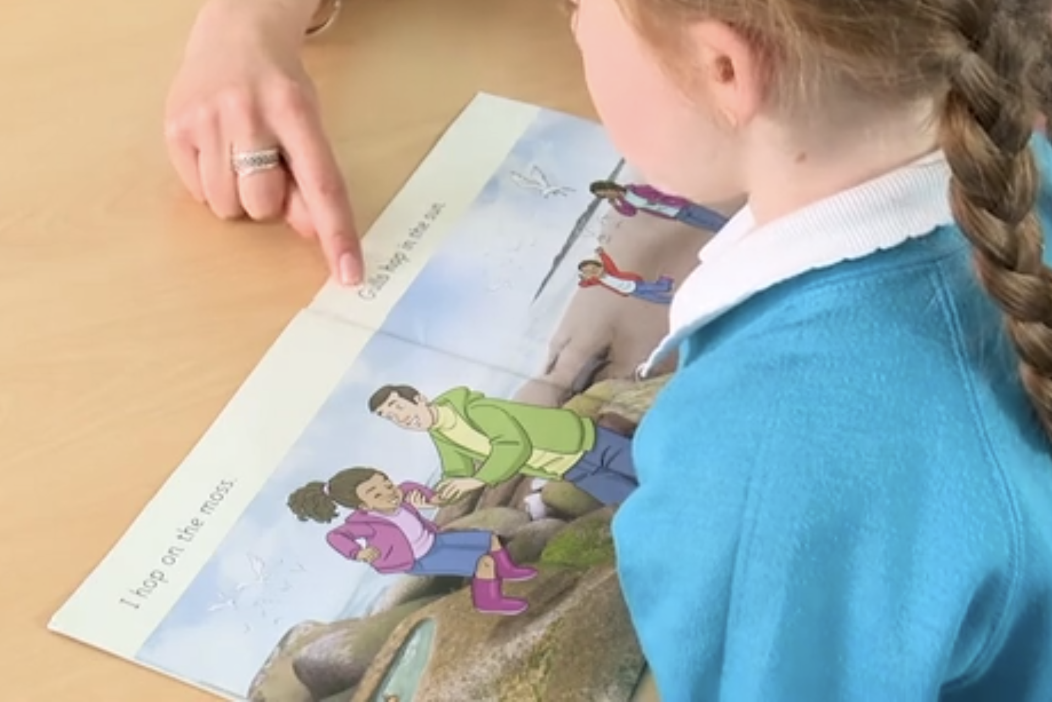
Reading a book at the right level
This means that your child should:
Know all the sounds and tricky words in their phonics book well
Read many of the words by silent blending (in their head) – their reading will be automatic
Only need to stop and sound out about 5% of the words by the time they bring the book home – but they should be able to do this on their own.
Notes:
I have left some books around the room for you to have a look at. I have got a range of stages from the foundation stage ‘wordless books’ to stage 5 which is the last stage before the children exit the phonics programme.

Slide 20
Reading at home

Slide 21
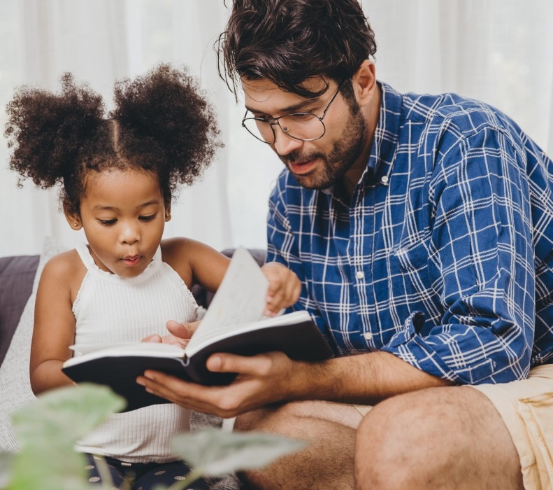
The most important thing you can do is read with your child
Reading a book and chatting to your child has a positive impact on your childs ability to…
understand words and sentences
use a wide range of vocabulary
develop listening comprehension skills.
The amount of books children are exposed to by age 6 is a positive predictor of their reading ability two years later.
Parental involvement in the development of children’s reading skills: A five-year longitudinal study (2002) Senechal, M. and Lefvre, J
Notes:
Celebrate child’s success at school, make time for reading at home!

Slide 22

Books going home
Notes:
As well as the ‘learning to read’ book that your child will bring home they will also bring home a book for sharing with you. This book is incredibly important. This is how we are going to give them the WILL to read. Please read with your child as often as you can – at least once a day if possible.
We will have dedicated time in school for your child to change their sharing book. It is your child’s responsibility to change this book. Adults in school will remind children on a regular basis but we like the children to become independent with their book changing and making their own choice when they need a new one and what book they would like to share at home.

Slide 23
Listening to your child read their phonics book
Your child should be able to read most or all of their book without your help.
If they cannot read a word read it to them.
Talk about the book and celebrate your childs success.
Notes:
This is a time for your child to show off to you. They have learnt all the necessary skills in school to decode, use prosody and also comprehend what is going on in the book.

Slide 24
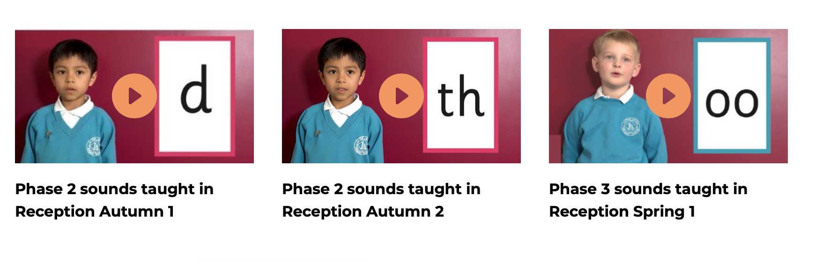
Supporting your child with phonics
Notes:
It is really important that you pronounce the sounds correctly at home if you are supporting your child. These videos are on the website for you to refer to and if you are unsure, please ask Myself, Mrs De-La-Hunty or Mrs Langford.
Show the parents where to access the videos on the website.
https://www.littlewandlelettersandsounds.org.uk/resources/for-parents/

Slide 25

Read to your child
The shared book is for YOU to read:
Make the story sound as exciting as you can by changing your voice.
Talk with your child as much as you can:
  Introduce new and exciting language
  Encourage your child to use new vocabulary
  Make up sentences together
  Find different words to use
  Describe things you see.
  Ask your child what might happen next.
  Ask your child to come up with an alternative ending.

Slide 26
One of the greatest gifts adults can give is to read to children
Carl Sagan

Slide 27
Questions?

