Slide 1






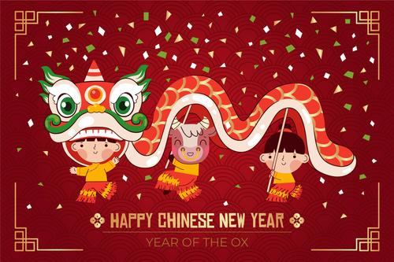

Expressive Art & Design
We are studying the artists Yayoi Kusama and Jackson Pollock and exploring their techniques to create our own very colourful artwork!
We will doing lots of painting! Using our fingers, painting outside, painting to music as well as combining it with collage.
We will also be designing a chair for one of the three bears!
Robin Class Topic Overview – Spring 1 2023
Literacy
We are reading the stories Super Milly and the Super School Day and Billy and the Beast and inventing our own superheroes with their own important qualities.
We will be writing short words, lists, and captions.
We will write a class story about a fictional superhero!
What is a Hero?
Communication & Language
We will practise orally retelling a traditional story that we are familiar with: Goldilocks and the Three Bears.
Personal, Social and Emotional Development
We will be celebrating Chinese New Year and Shrove Tuesday
We will learn why and how these customs are celebrated
We will learn the importance of respecting customs which might differ from our own
We will discuss the qualities we think heroes should have e.g. kindness, bravery
Physical Development
We are continuing to practise our fine motor skills daily and securing a correct and comfortable pencil grip.
Our P.E. focus this half term is Gymnastics. We will be:
Copying and creating shapes
Creating shapes on apparatus
Developing balancing and weight on different body parts
Jumping and landing safely
Rocking and rolling
Creating short sequences of movement
Understanding the World
This half term we are looking at the weather and the seasons. We will be:
Learning about different types of weather and how it changes with the four seasons
Recording weather observations
Exploring clouds and how they are formed
Exploring shadows
Mathematical Development
We will be:
Counting, writing and ordering numbers
Introducing 0 and comparing to 5
Understanding the composition of 5
Comparing mass and capacity
Making pairs and combining two groups
Investigating length, height and time
Phonics
In phonics we will learn the following digraphs: ai,ee,igh,oa,oo,OO,ar,or,ur, ow,oi,ear,air,er, and read and spell words with double consonants, as well as longer words.
British Values
We are learning about tolerance of different faiths and beliefs
Religious Education
We will learn about the Easter Story and why Easter is so important to Christians.

